Slide 1
Cluster Expansion for Pd dynamics

Slide 2
Steps
1. Try 2D layer first
7 clusters
Less than 20 configurations (some of them are not 2D)

Slide 3
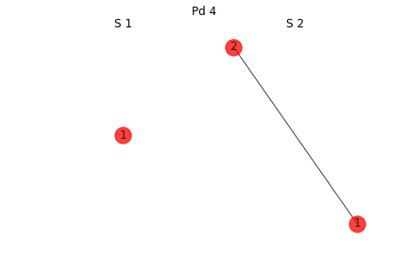
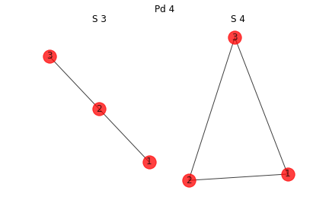
Clusters 1

Slide 4
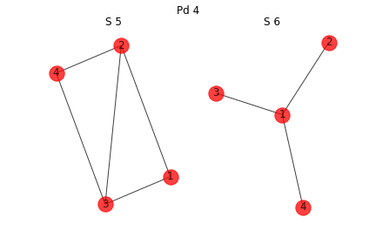
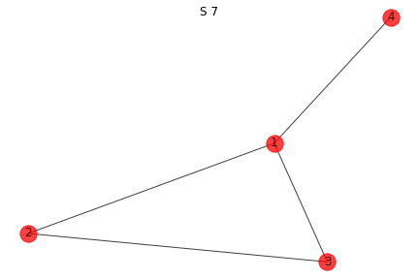
Clusters 2

Slide 5
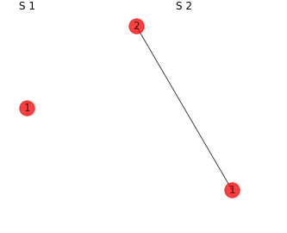
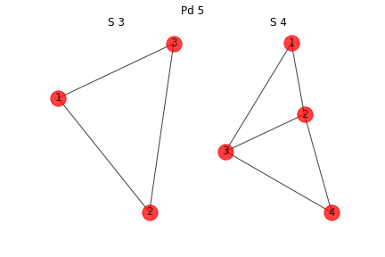
Configurations 1

Slide 6
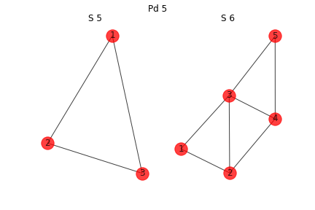
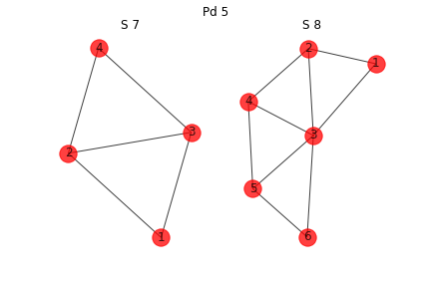
Configurations 2
This is a 3D cluster
This is a 3D cluster

Slide 7
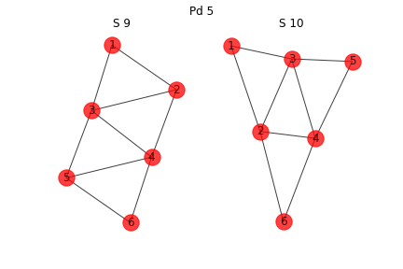
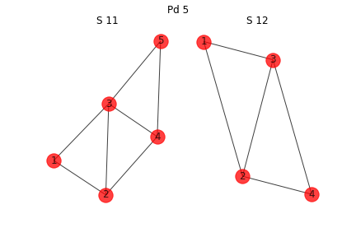
Configurations 3
This is a 3D cluster
This is a 3D cluster

Slide 8
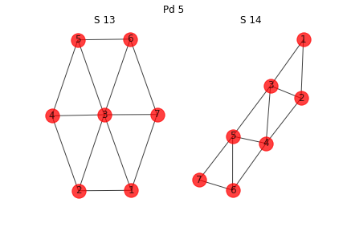
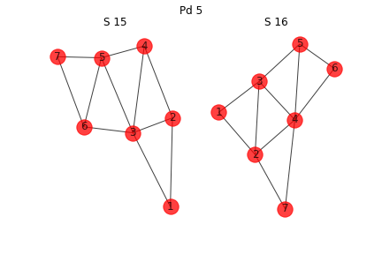
Configuration 4

Slide 9
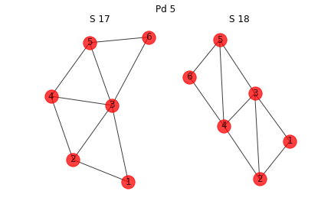
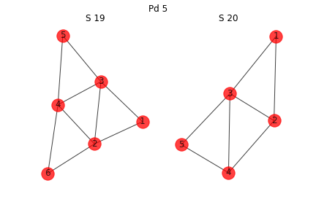
Configuration 5
This is a 3D cluster
This is a 3D cluster
This is a 3D cluster
This is a 3D cluster

Slide 10
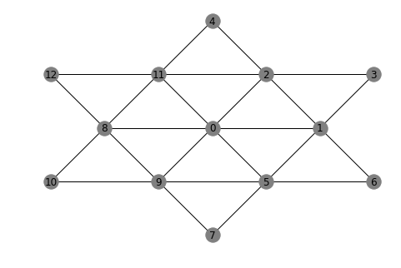
Lattice

Slide 11
Model 2D configuration first
12 of them
Pd1 (T) | 0
Pd2 | -0.45
Pd3 | -1.5
Pd4 | -2.56
Pd5 | -3.41
Pd6_1 | -4.49
Pd6_2 | -4.38
Pd6_3 | -4.32
Pd7_1 | -6.07
Pd7_2 | -4.9
Pd7_3 | -5.11
Pd7_4 | -5.12

